Slide 1
Data analysis in business development
By Mgbecheta Paschal Chukwudubem
JANUARY 2025

Slide 2


TALKING POINTS
What is data?
Why Business development?
Key Insights
2024 trends
Dashboard Overview
A quick demo
Issues encountered
What is possible?
Final Takeaways

Slide 3

WHAT IS DATA?

Slide 4

WHY BUSINESS DEVELOPMENT?
Predict and anticipate opportunities
Bid submission success rate
Isolate high potential clients
Tender duration
Identify weak areas in Makais

Slide 5
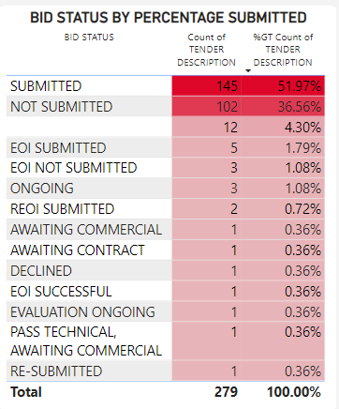
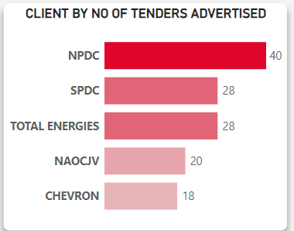
KEY INSIGHTS
Makais has an approx. 52% bid submission rate
NPDC (40) and SPDC (28) are the most active clients over the years

Slide 6
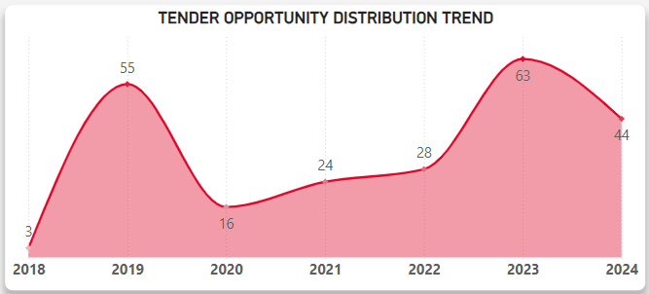
KEY INSIGHTS
2023 was the busiest year on record (63 tenders received)

Slide 7
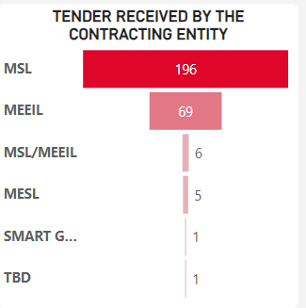
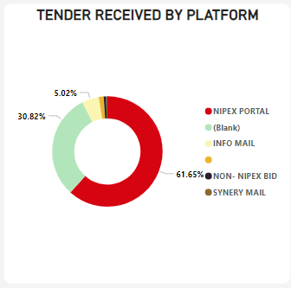
KEY INSIGHTS
Makais Synergy has received 70% (196) of all tenders historically
NIPEX portal accounts for 62% of all tenders received

Slide 8
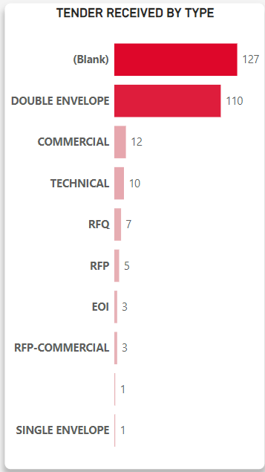
KEY INSIGHTS
Double envelopes are undoubtedly the most common tender types

Slide 9
2024 TRENDS
CHEVRON showed growth advertising 8 tenders 44% of its historical total.
Submission rates plummeted to 32%, with 63% not addressed.
Tender opportunity peak months of March(9), May(8) and July(12) stayed consistent with historical trends
Makais Synergy received 59% of all tenders
NIPEX accounted for a historic high of 81% of all tenders received.
Double envelope tenders remained dominant (91% o all tenders received)

Slide 10
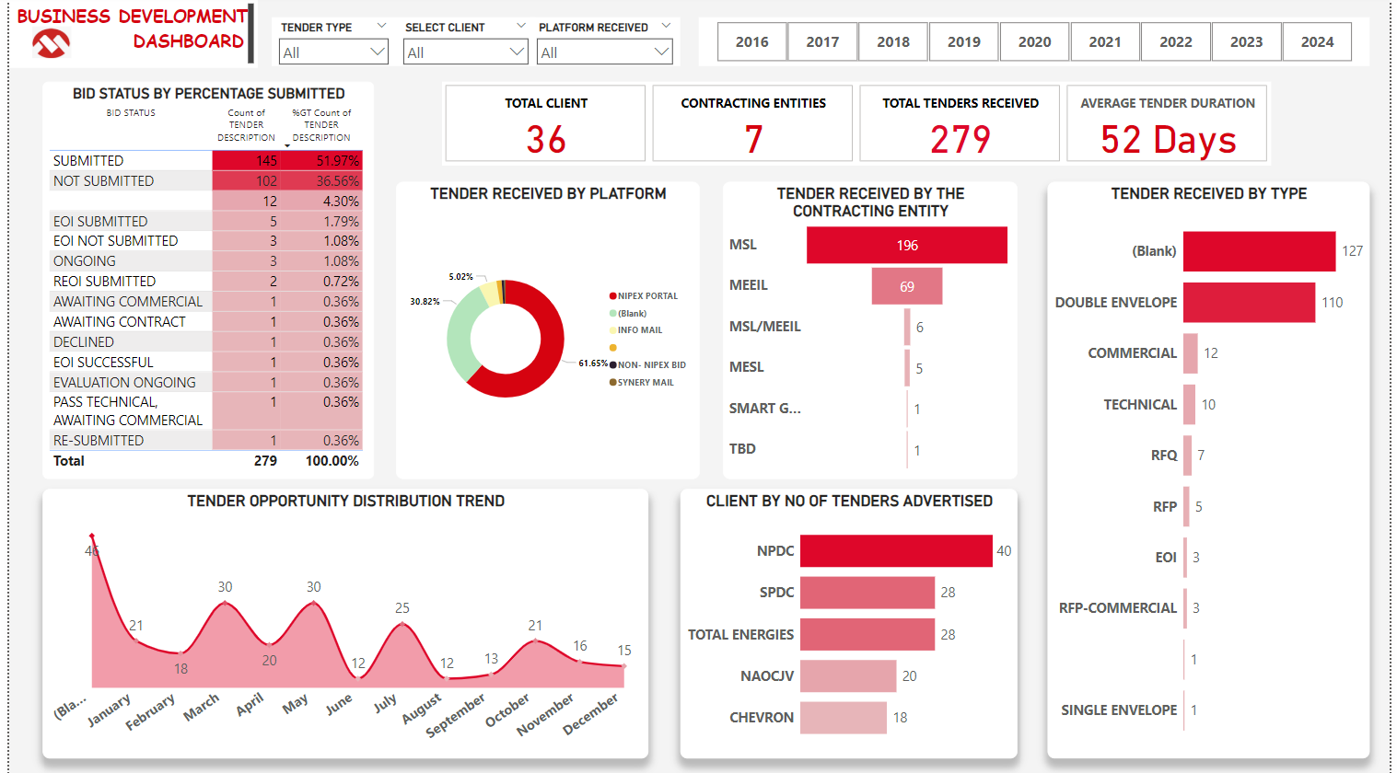
DASHBOARD OVERVIEW

Slide 11

QUICK DEMO

Slide 12
ISSUES ENCOUNTERED
A disproportionate number of missing data (32% of platform received and 45% of tender type columns) in key columns potentially affecting final analysis.
A fair amount of nonsensical data eg in the date columns exist
Conflicting information from other similar datasets
Bloated use of similar words.
Too many redundant datasets

Slide 13
WHAT IS POSSIBLE ?
Predict
Predict the future based on historical data e.g. peak month over month trends
Isolate
Isolate underperforming sectors
Discover
Discover potential future leads and clients
Discover
Discover workflows and processes due for optimizations
Better
Better quality data equals more precise insights
Finance department
This can potentially completely change how finances (spending and earnings) are documented and reported

Slide 14
FINAL TAKEWAWAY
“DATA IS THE NEW OIL” – CLIVE HUMBY
“WHERE THERE IS DATA SMOKE, THERE IS BUSINESS FIRE.” — THOMAS REDMAN

Slide 15
THANK YOU !

